Slide 1
Solving the Puzzle of Participation
Helen Whitehead
Learning Technology

Slide 2
What we’ll be doing…
Introductory presentation and demo of online activities (15 min)
Comments / Questions
Introduce frameworks/templates
Group work / game jam (20 min)
Feedback and Next Steps

Slide 3
Examples to try
Farmer (fox/chicken/grain) puzzle:
https://xot.xerte.org.uk/play.php?template_id=9&page=21
Foodle: Search Moodle Password: SoftChase££
All Aboard Digital Skills (information about, not ready to play yet) http://www.allaboardhe.ie/
Inanimate Alice interactive fiction https://inanimatealice.com/
Breathe (must use your smartphone for this one) – an interactive ghost story – go to https://www.breathe-story.com/ and follow the instructions.

Slide 4
Narrative
Narrative, agency and where do puzzles fit in?

Slide 5

Why Narrative?
Narrative-based learning
Helps learners understand and make sense of their learning
Makes navigation easier
Serves as a cognitive framework for problem solving
Provides opportunities for reflection, evaluation, illustration, exemplification, inquiry
Grounded, situated, experiential
X
Digital
storytelling

Slide 6
Agency
Learners have a sense of control and power to affect their learning
The most transformative learning experiences
will be those that are directed by
the learner’s own endeavors and curiosities*
* Lindgren & McDaniel (2012)
Choices…
Notes:
Piagetian notion of constructivism
Knowledge is constructed from taking action
" Likewise, there are additional questions about agency that could be asked such as how consequential the choices students are given need to be. For example, should students be allowed to make decisions that could put them on a sub-optimal path or even failure?

Slide 7
Narrative
Compelling and engaging narratives
allow for immersion and agency,
demand the participation of users and yet
also provide scaffolding for problem solving
Flow…

Slide 8
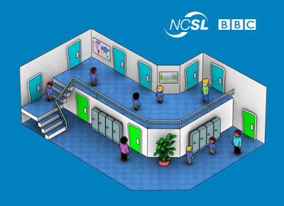
Existing uses of narrative
Use technology to bring to life:
Scenario-based learning
Situated learning
Simulation
Problem-based learning
Use video for authenticity
Difficult to produce:
Require programming, video and/or illustration and animation skills
Virtual School
Midwifery in Second Life
Notes:
Scenarios and problem based learning have been used for decades – in what way is this new?

Slide 9
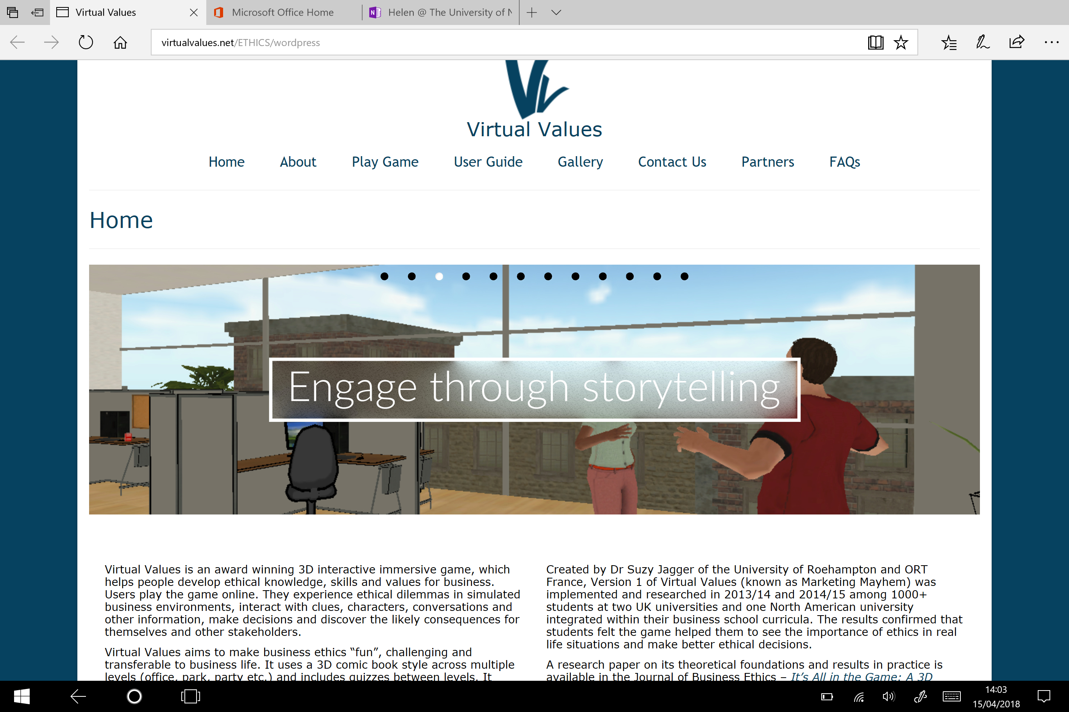

Slide 10
Ideas for using narrative
Role play in Chat
Transmedia (Twitterstory)
Backstory: Use video (cf escape games)
Cut scenes
"Key story components were released to students at four points in the semester including at the very beginning of the course and the very end of the course. " Lindgren et al
Notes:
Cut scenes - short sections of narrative interspersed and revealed during the course of game play

Slide 11
Relate everything to Learning Outcomes
Escape from Paper Mountain
Learning outcomes
Awareness of Feedback Studio – what it can do
Positive buzz around online marking
Some practice of basic tasks
Confidence in approaching online marking
Potential of escape games in own teaching

Slide 12
Creating narrative
Narrative structure and implications for learning design

Slide 13
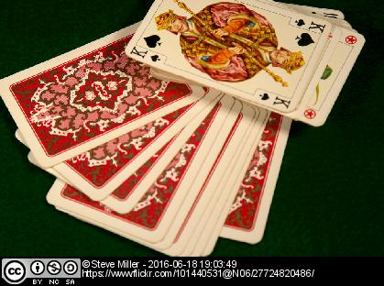
Features of narrative (relate to learning outcomes!)
Setting/background
Character (with a flaw –
causing a problem)
Plot
Challenge
Tasks
Triggers – plot hooks
Emotional context and proximity
Notes:
Plot hook - an in-game element that inspires a strong motivation to pursue a course of action that furthers the plot or enriches a narrative in a game.
Emotional proximity – empathy and identification a participant feels towards another character (could be another participant or a fictional character)

Slide 14
Interactive Fiction
Twine http://twinery.org/
Interactive fiction competition
https://ifcomp.org/comp/2017
Inanimate Alice
https://inanimatealice.com/
“digital-born reading experience”
An interactive story for your smartphone: Kate Pullinger's Breathe https://www.breathe-story.com

Slide 15
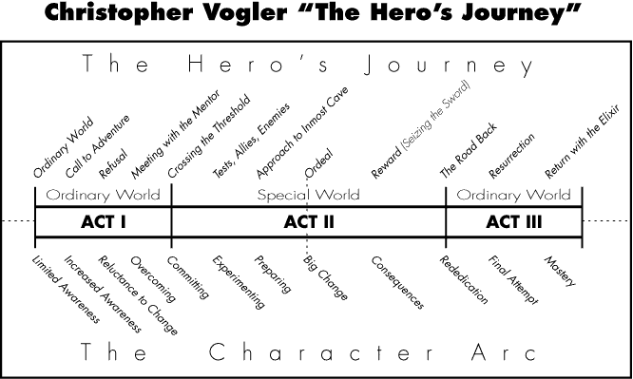
Narrative Devices
The Hero’s Journey
Three Act Structure
Notes:
Christopher Vogler re-interpreted Joseph Campbell’s Hero with Many Faces

Slide 16
Labov’s Natural Stories
Six common elements in stories we tell each other
Abstract (set-up): Purpose
Orientation (background): Who, when, where and/or why
Complicating Action: Initiates the plot
Resolution: What happened: resolution of the problem
Evaluation/ Reflection: Interpretation, meaning, explain why the story is being told, why the events are notable
(useful for learning points)
Coda: Returns to the present, story over. “We all lived happily ever after!"
Notes:
Orientation of the story, such as, "My sister and I were walking along the shore and collecting shells."
"It's a good thing we were there or who knows what might have happened!"

Slide 17
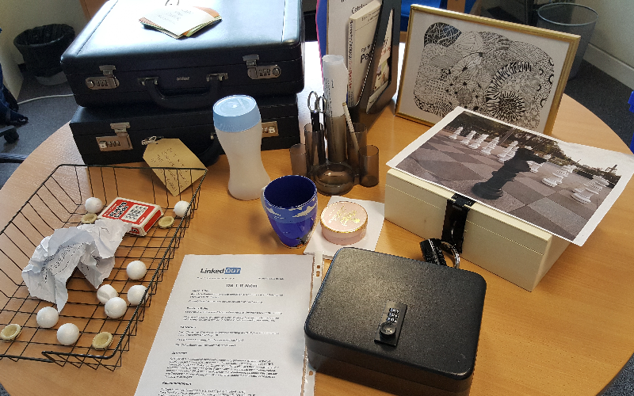

Escape to Paper Mountain
Dr T R Nitin has disappeared. You’re
in his office.
He was in the middle of his marking,
and the exam board are meeting in
60 minutes.
Before then, you, his colleagues, will
need to finish his marking for him –
and find out where he has gone.
He left reminders to himself of the
marks all over his office – you’ll
need to find and interpret them.

Slide 18
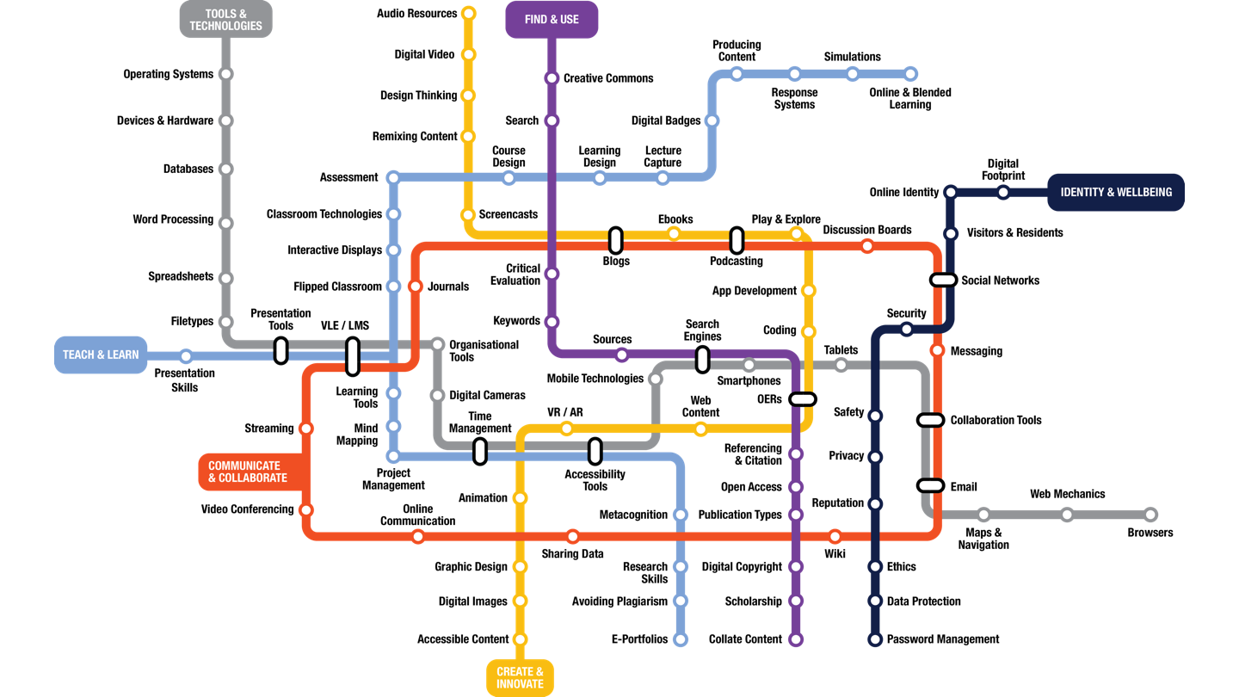
http://www.allaboardhe.ie/
training in digital skills in the form of a metro map
Notes:
The metaphor extends the notion of exploration, journey and progress, alongside the separate categories in each of the metro lines, each of which corresponds to broad areas relevant to anyone teaching, learning, or indeed being creative in a digital space.

Slide 19
Gamification
Using game elements, puzzles, and how to escape!

Slide 20
Gamification
Applying game design thinking to design for learning to make learning experiences more motivating and engaging
Remember MYST?
Endogenous not exogenous
Easter Eggs !!

Slide 21
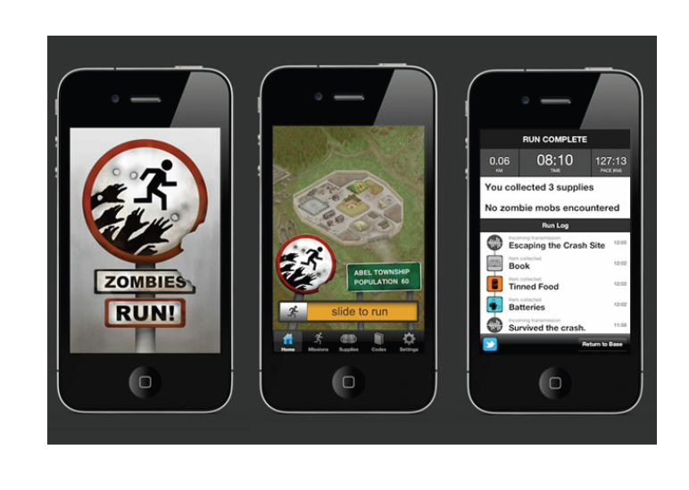
Gamification
Gamification elements:
Content unlocking
Missions / Quests / challenges
Progression: Progress tracking
Resource collection, Virtual Goods
Trophies, Rewards, Points, Badges
Levels
Avatars
Feedback
Social interaction, e.g., competition, social graph, leaderboard, teams

Slide 22
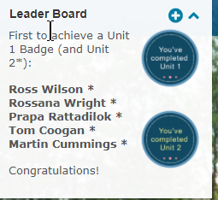
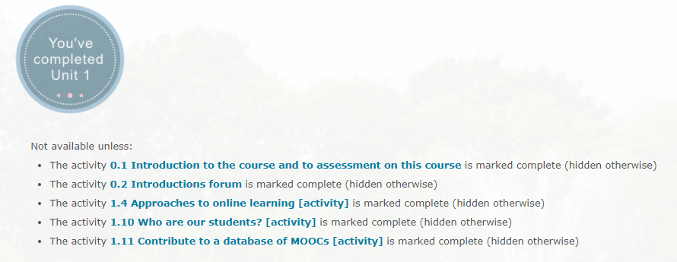
Online Facilitation and Designing for Engagement
Motivational badges vs. Open Badges

Slide 23
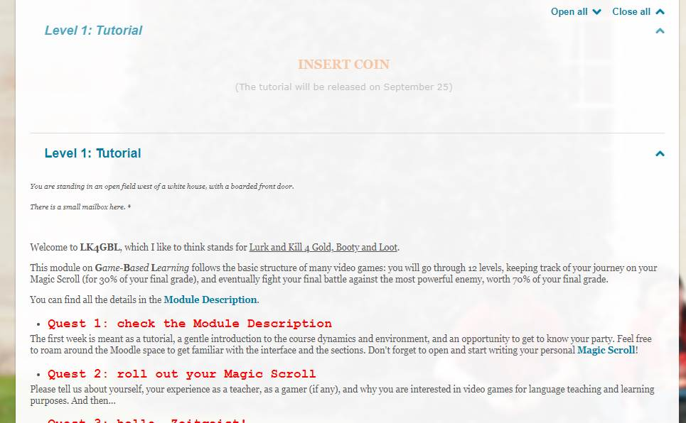
Notes:
(MA in Digital Technologies for Language Teaching) , but be aware that I do not teach it. The tutor is Ivan Lombardi, who teaches the module for Cecilia Goria from Fukui University, Japan.

Slide 24
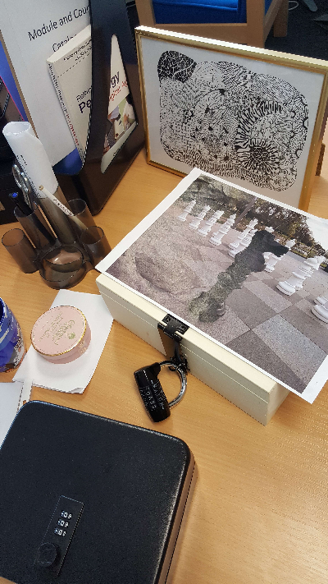
Escape Gamification?
What are the elements of escape games that make them engaging and how can we apply these to the design of learning activities?
The students want to escape the module!
Narrative
Collaboration... ??
Goal-oriented
Puzzle elements!
Notes:
Whole course is an escape game – the students want to pass the exam... finish the coursework....

Slide 25
Puzzles and Problem Solving
Puzzle types & taxonomy
Logic puzzles (eg iterative, learning)
Mechanical puzzles (eg routefinding, assembly)
Codes and ciphers
Ordering puzzles (LATCH)
Reveal puzzles (needs a tool to reveal)
Hidden in plain sight

Slide 26

Puzzle categorisation
Learning style
Senses
Linguistic, logic, visual/spatial,
musical, physical, naturalistic
Reflector/Pragmatist/Activist/Theorist
Problem-solving, collaboration,
communication, concentration,
numeracy literacy…
Subject knowledge
Convergent/divergent thinking

Slide 27

Example puzzle 1
This is a puzzle that leads to a
letter code for a padlock like this:
quack viz fjords next bmw
Notes:
glyph

Slide 28
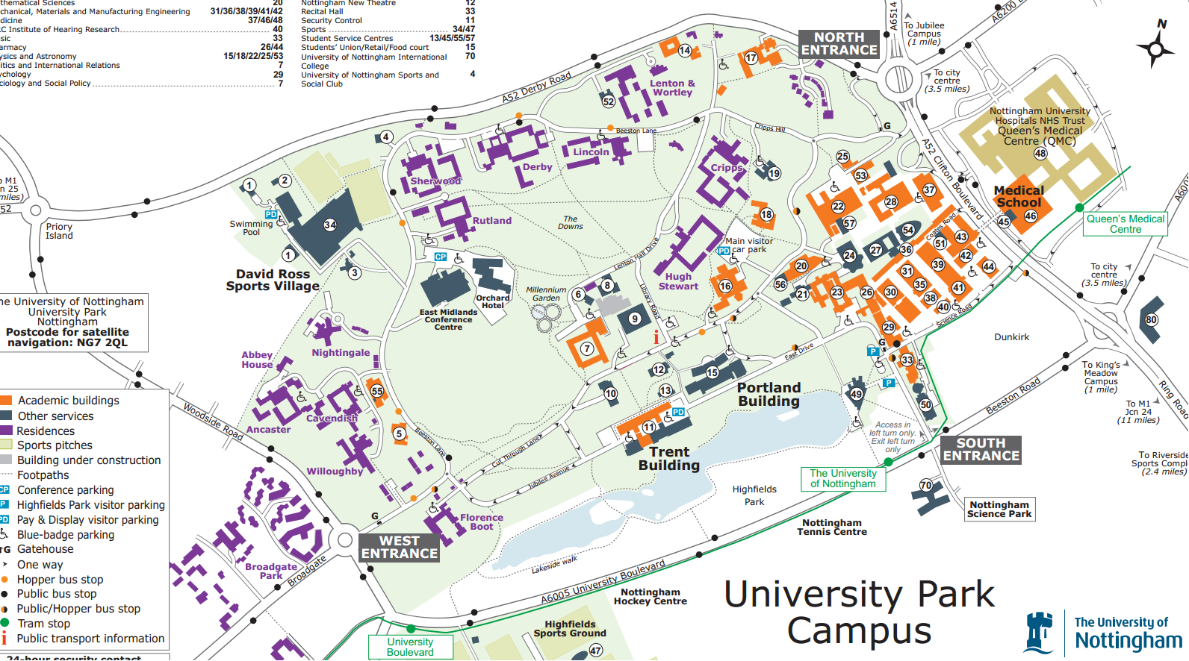
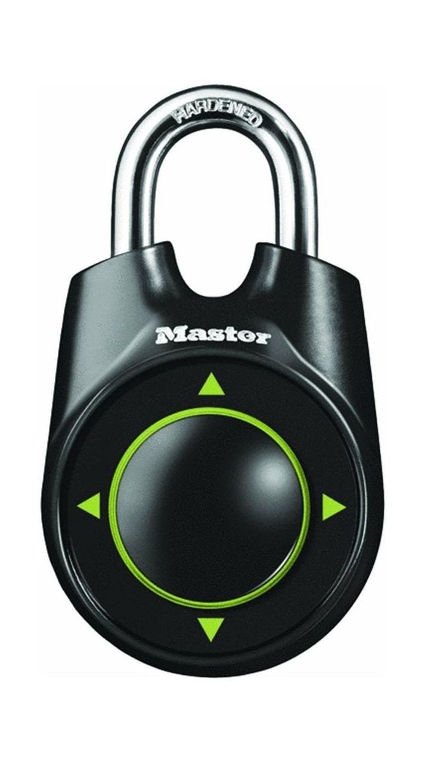
Example puzzles
10-8-16-41-43-54-31
This is a puzzle that leads to a
letter code for a padlock like this:
quack viz fjords next bmw

Slide 29
Using Puzzles
Suggest start with:
Quest – learner does research and finds out the answer to unlock the next level
Logic puzzle
Code
Can be a branching activity or choices at each level
Collaboration - students collaborate in creating their own puzzles (game jam)
Notes:
See handoutcf. PeerWise

Slide 30
Practicalities
Moodle, templates & frameworks

Slide 31
Moodle activities and features
Conditional resources and activities
Completion tracking
Restrict Access
Badges
moodle.nottingham.ac.uk
Forum
Quiz
Lesson
Wiki
Chat
Xerte Online Toolkits
https://xot.xerte.org.uk/play.php?template_id=9&page=21

Slide 32
References
Campbell, J. (1973) The Hero with a Thousand Faces, 21st Ed., Princeton University Press
Conle, C. (2003). An anatomy of narrative curricula. Educational Researcher, 32 (3), 3–1
Csikszentmihalyi, M. (1990) Flow: the psychology of optimal experience, New York : Harper & Row
Dickey, M. (2006). Game Design Narrative for Learning: Appropriating Adventure Game Design Narrative Devices and Techniques for the Design of Interactive Learning Environments Educational Technology Research and Development 54 (3), 245-263
Labov, W., & Waletzky, J. (1997). Narrative analysis: oral versions of personal experience. Journal of Narrative and Life History 7 (1–4) 3-38
Laurillard, D., Stratfold, M., Luckin, R., Plowman, L. & Taylor, J. (2000). Affordances for learning in a non-linear narrative medium. Journal of Interactive Media in Education (2).
Lindgren, R., & McDaniel, R. (2012). Transforming Online Learning through Narrative and Student Agency. Educational Technology & Society, 15 (4), 344–355.
Paulus, T M., Horvitz, B., & Shi, M. (2006). "Isn't It Just like Our Situation?" Engagement and Learning in an Online Story-Based Environment Educational Technology Research and Development, 54 (4), 355-385
Rieber, L. P. (1996). Seriously considering play: Designing interactive learning environments based on the blending of microworlds, simulations, and games. Educational Technology Research & Development, 44(2), 43–58.
Vogler, C. (1998). The writer’s journey: Mythic structures for writers. Studio City, CA: Michael Wiese Productions

Slide 33
Moving on & Help
Moodle support
Carpe Diem type workshops
HELM course on FutureLearn
ALT's Playful Learning SIG
Narrative techniques for learning
http://usablelearning.com/2013/03/20/narrative-strategies-for-learning/
ed learning

Slide 34
Thank you
Helen Whitehead
Helen.Whitehead@nottingham.ac.uk
Alvaro Roberts
Alvaro.Roberts@nottingham.ac.uk

